Slide 1
European Regulatory Environment (just a part!)
Mark Thomas, ECO Director
CEPT Workshop on European Spectrum Management and Numbering
4th June 2014

Slide 2
National and European-wide regulations
CEPT
Conference of European
Post & Telecom Administrations
48 countries
ECO
National
Administrations
EU
European Union
28 countries
EC
MoUs
ETSI
Governmental &
industry members
Studies, consultations
Lobby, consultations
Lobby
Direct input
Manufacturers/operators/organisations

Slide 3
EU vs. Non-EU regulations: what is it about???
EMC
R&TTE
Directive
Spectrum
Decision
Is this a diagram of a heating system?
TCAM
RSC
98/34
Spectrum Decision Process
Harmonised
Standards
Commission
Decisions
EU members
Industry
HS
EC
EC
Decisions
EU
Standards
CEPT Reports
Non-EU
M
A
N
D
A
T
E
S
M
A
N
D
A
T
E
S
Industry
SRDoc
CEPT members
EN
ECC Decisions
ECC Recommendations
ECC Reports
CEPT Reports
Standards
Liaison Statement

Slide 4
EU vs. Non-EU regulations: what is it about???
EMC
R&TTE
Directive
Spectrum
Decision
TCAM
RSC
H E L P !!
98/34
Spectrum Decision Process
Harmonised
Standards
Commission
Decisions
EU members
Industry
HS
EC
EC
Decisions
EU
Standards
CEPT Reports
Non-EU
M
A
N
D
A
T
E
S
M
A
N
D
A
T
E
S
Industry
SRDoc
CEPT members
EN
ECC Decisions
ECC Recommendations
ECC Reports
CEPT Reports
Standards
Liaison Statement

Slide 5
European regulatory framework for radio spectrum and equipment
Read more at
http://apps.cept.org/
eccetsirel/

Slide 6
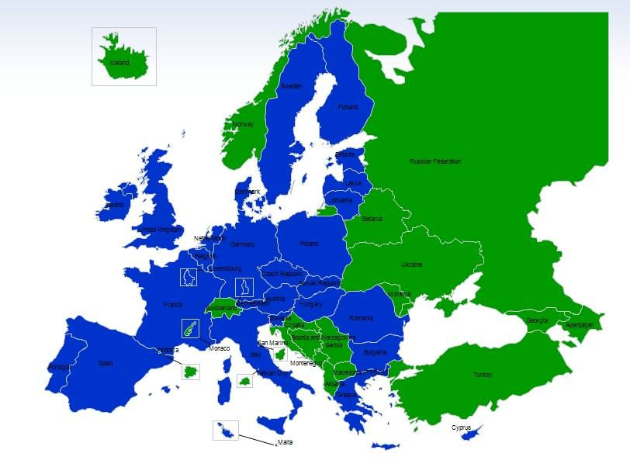
Roles of the three European regulatory organizations
European Commission:
Single market issues
Binding regulations based on the technical expertise of CEPT/ECC
and harmonised standards of ETSI (28 Member States)
CEPT/ECC:
Consensus and voluntary character
Spectrum designation to systems/applications and technical conditions for its use
(48 member countries)
ETSI:
European Harmonised standards (EN) for radio equipment
‘System Reference Documents’ (SRDoc) which inform and trigger much of the CEPT/ECC work
(over 700 industry members &
and European naitonal regulators)

Slide 7
EC Roles
Propose legislation to Parliament and Council
Administer and implement Community policies
Enforce Community law
Negotiate international agreements, mainly those relating to trade and cooperation

Slide 8
CEPT footprint: all EU Member States + rest of Europe
EU states shown in blue

Slide 9
EU radio spectrum policy
Coordinate spectrum management approaches across the Union
Objectives:
Support the internal market for wireless services
Foster innovation in electronic communications and other sectors
Harmonise access conditions at EU level
Ensure efficient use of radio spectrum
Enable interoperability of radio equipment
More flexibility through the principles of technology and service neutrality and the possibility for users to transfer and lease rights to use spectrum under certain conditions

Slide 10
European Commission: “DG CONNECT” and “Enterprise and Industry”
Directorate General (DG) CONNECT:
Driven by ‘Radio Spectrum Policy Programme’ (RSPP – agreed by EU member states, via EP and Council)
RSC
RSPG
more..
Enterprise and Industry:
TCAM
more…

Slide 11
European Commission: Radio Spectrum Committee (RSC or ‘RSComm’)
A committee that makes decisions which bind EU member states
Chaired by the Commission
”Comitology” (eh, what’s that?)
Commission takes initiatives, member states and Commission have to agree on outcomes
RSComm can take Decisons, but some regulations need to be agreed by EU Council and Parliament – e.g. RSPP
RSComm meets 4 time per year

Slide 12
European Union Radio Spectrum Policy Group (RSPG)
A high level advisory policy group of member states
Chaired by a member state; changes every two years
Commission provide the secretariat
Provides a top-level policy focus and context for Commission to recognise MS views
Has a work programme, reviewed every 1-2 years
Meets 3 times per year
Has become quite detailed in its reports
Member state commitment to working groups quite high; ECO has supported a few of the groups (to input ECC contributions)

Slide 13
BEREC
A body of EU national regulators concerned with telecoms regulation
Committee is made up of NRAs
Supported by a secretariat which is an EU Agency (in Riga)
i.e. an arm’s length part of the Commission
Concerned with economic regulation and telecommunications networks; interest in spectrum is less direct, and not technical.

Slide 14
Transition from R&TTE to RED Directive
R&TTE Directive regulates placing radio & terminal equipment on the European market and putting it into service
Manufacturers usually apply Harmonized Standards developed by ETSI and CEN/CENELEC for placing equipment on the market
Market Surveillance Authorities (MSA) are responsible for national implementation of the R&TTE Directive
TCAM Committee is ”monitoring” the implementation of the R&TTE Directive
R&TTE Directive will be repealed on 13 June 2016
The new Radio Equipment Directive (RED) also covers receivers

Slide 15
ETSI: European Telecommunications Standards Institute
ETSI was created by CEPT in 1988
Produces standards and SRDocs for ICT, including fixed, mobile, radio, converged, broadcast and internet technologies
Not-for-profit organisation; more than 700 member from 62 countries
Recognized by the European Union as a European Standards Organisation
CEPT and ETSI cooperate based on a Memorandum of Understanding (MoU)

Slide 16
ETSI (2)
Wide range of activities
Success in standardisation: Low Power Radio, Short Range Devices, TETRA, GSM
Find more at: www.etsi.org

Slide 17
European regulatory framework for radio spectrum and equipment
Read more at
http://apps.cept.org/
eccetsirel/

